Slide 1
LIBRARY MANAGEMENT SYSTEM
By Diya Patel, Devansh Kadam & Adeesh Shetty

Slide 2
CONTENT
Overview
Entities
ERD
Data Dictionary
Creating Tables
Populating Data
Queries
Creating View
Creating Index

Slide 3
OVERVIEW – LIBRARY MANAGEMENT SYSTEM
The details of Books are stored into Books table respective with all tables
Each entity (Books, Member, Librarian, Issues) contains primary & unique keys
The entities Books, Customer have bonded with Librarian, Issues entities with foreign key.
The objective is to make finding of the book and managing the library easier

Slide 4
ENTITIES
BOOKS
Book_ID
Book_Name
Book_Author
Book_Price
MEMBER
Member_ID
Member_Name
Member_Phone
Member_Email
LIBRARIAN
Lib_ID
Librarian_Name
Librarian_Phone
Librarian_Email
ISSUES
Member_Name
Book_ID
Issue_date
Issue_returndate
Lib_id

Slide 5
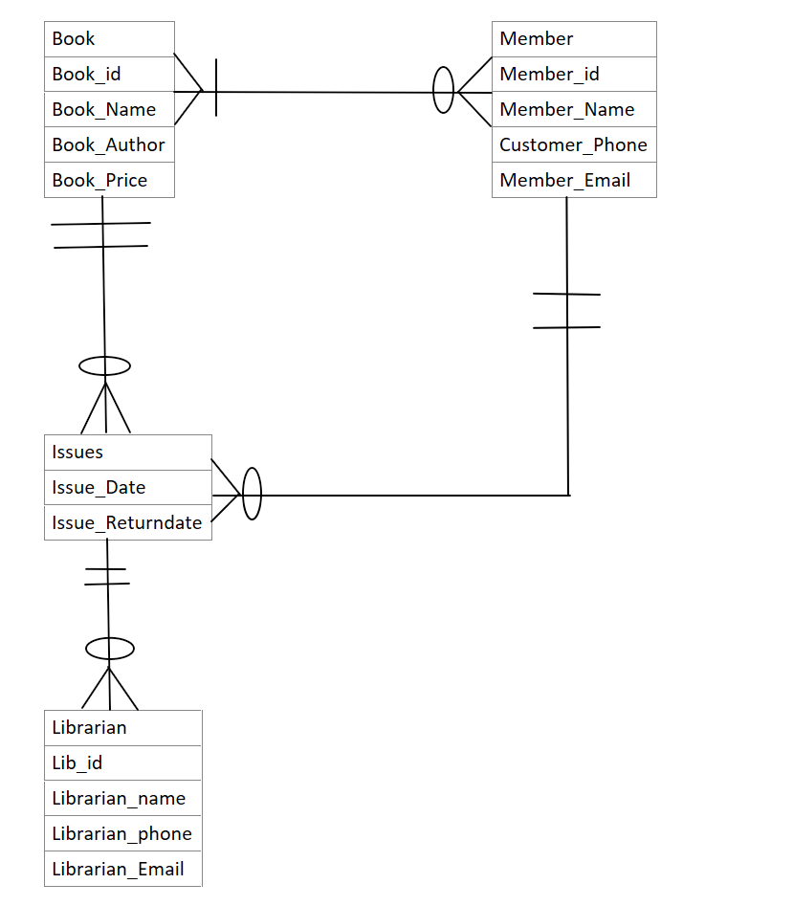
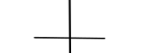
ERD

Slide 6
Data Dictionary
FIELD | TYPE | LENGTH | CONSTRAINT
Book ID | INT |  | NOT NULL
Book Name | VARCHAR | 30 | NOT NULL
Book Author | VARCHAR | 30 | NOT NULL
Book Price | INT
Member ID | INT |  | NOT NULL
Member Name | VARCHAR | 30 | NOT NULL
Lib ID | INT |  | NOT NULL
Member Phone | INT |  | NOT NULL
Member Email | VARCHAR | 30 | NOT NULL
Librarian Name | VARCHAR | 30 | NOT NULL
Librarian Phone | INT |  | NOT NULL
Librarian email | VARCHAR | 30 | NOT NULL
Book Id | INT |  | NOT NULL
Issue Date | DATE
Issue Renewal | DATE

Slide 7
TABLE BOOKS & TABLE CUSTOMER
QUERY TO CREATE TABLE BOOKS
create table Book (book_id int not null,book_name varchar(30) not null, book_author varchar(30) not null, book_price int, constraint primary key(book_id));
THIS TABLE KEEPS THE RECORD OF THE INFORMATION OF THE BOOKS IN THE LIBRARY
QUERY TO CREATE TABLE MEMBER
create table member(member_id int not null,member_name varchar(30) not null,lib_id int not null,member_phone int not null, member_email varchar(30) not null constraint primary key(member_id),constraint foreign key(lib_id);
THIS TABLE KEEPS THE RECORD OF THE INFORMATION OF THE CUSTOMERS IN THE LIBRARY WITH THEIR RESPECTIVE BOOK IDS
BOOKS
Book_ID
Book_Name
Book_Author
Book_Price
MEMBER
Member_ID
Member_Name
Book_ID
Lib_ID
Member_Phone
Member_Email

Slide 8
TABLE LIBRARIAN & TABLE ISSUES
QUERY TO CREATE TABLE LIBRARIAN
Create table Librarian(lib_id int not null, librarian_name varchar(30) not null, librarian_phone int not null, librarian_email varhar(30) not null ,constraint primary key(lib_id);
THIS TABLE KEEPS THE RECORD OF THE INFORMATION OF THE LIBRARIAN IN THE LIBRARY
QUERY TO CREATE TABLE ISSUES
create table Issues(member_name varchar(30) not null,book_id int not null,issue_date date not null default ‘2022-01-01’,issue_returndate date);
THIS TABLE KEEPS THE RECORD OF THE INFORMATION OF THE ISSUE DATE, RENEWAL ALONG WITH CUSTOMER NAME
LIBRARIAN
Lib_ID
Librarian_Name
Librarian_Phone
Librarian_Email
ISSUES
Member_Name
Book_ID
Issue_Date
Issue_Returndate

Slide 9

INSERTING VALUES INTO TABLE BOOKS
These are the queries to insert values into the table
“BOOKS”
insert into Books value(001,'Harry Potter Goblet of Fire','J.K Rowling',400); insert into Books value(002,'Percy Jackson','Rick Riordan',450);
insert into Books value(003,'Sapiens','Yuval Noah Harari',500); insert into Books value(004,'Ikigai','Francesc Miralles',250);
insert into Books value(005,'Richman Poorman’, 'Robert Kiyosaki',300); insert into Books value(006,'First Things First','Stephen Covey',600); insert into Books value(007,'Atomic Habits','James Clear',525);
insert into Books value(008,'IT(Novel)','Stephen King',500); insert into Books value(009,'Da Vinci Code','Dan Brown',1500);
insert into Books value(010,'Lord of the Rings','J.R.R Tolkien',1000);
BOOKS
Book ID
Book Name
Book Author
Book Price

Slide 10
INSERTING VALUES INTO TABLE MEMBER
These are the queries to insert values into the table “MEMBER”
MEMBER
Member_ID
Member_Name
Member_Phone
Member_Email
Insert into member values(1001,'Liam',2,854585,'liam123@gmail.com');
insert into member values(1002,'Noah',3,034875,'noah153@gmail.com’);
insert into member values(1003,'Elena',1,597298,'elena623@gmail.com’);
Insert into member values(1004,’Stephan’,586357,’Stephan173@gmail.com’);
insert into member values(1005,'Rick',3,884765,'rick103@gmail.com’);
insert into member values(1006,'Jeremy',1,971775,'jeremy129@gmail.com’);
insert into member values(1007,'Damon',3,674489,'damon1234@gmail.com’);
insert into member values(1008,'Ross',2,947584,'ross166@gmail.com’);
insert into member values(1009,'Chandler',1,859580,'chandler69@gmail.com’);
insert into member values(1010,'Joey',2,856489,'joey181@gmail.com');
Lib_id

Slide 11

INSERTING VALUES INTO TABLE LIBRARIAN
These are the queries to insert values into the table
“LIBRARIAN”
LIBRARIAN
Lib ID
Librarian Name
Librarian Phone
Librarian Email
insert into librarian values(1,'john',76897,'john123@gmail.com’);
insert into librarian values(2,'shaun',99655,'shaun153@gmail.com’); insert into librarian values(3,'launa',97654,'launa623@gmail.com');

Slide 12

INSERTING VALUES INTO ISSUES
These are the queries to insert values into the table
“ISSUES”
ISSUES
Customer Name
Book_ID
Issue_Date
Issue_Returndate
insert into issues values('Liam',004,'2022-10-11','2022-10-29’);
insert into issues values('Noah',007,'2022-09-13','2022-09-30’);
insert into issues values('Elena',008,'2022-11-02',null);
insert into issues values('Stephan',002,'2022-01-12','2022-01-30’);
insert into issues values('Rick',001,'2022-05-10','2022-05-29’);
insert into issues values('Jeremy',003,'2022-03-07','2022-03-21’);
insert into issues values('Damon',005,'2022-04-01',null);
insert into issues values('Ross',006,'2022-12-11','2022-12-30’);
insert into issues values('Chandler',009,'2022-09-01','2022-09-20’);
insert into issues values('Joey',010,'2022-07-07','2022-07-27');

Slide 13
QUERIES
select * from book where book_price < 500;
select member_name,b.book_id,book_name from issues i join book b on i.book_id=b.book_id where member_name='Chandler’;
select * from issues where issue_date < '2022-06-01’;
select l.lib_id,librarian_name,m.member_name from librarian l join member m on l.lib_id=m.lib_id having lib_id='2’;
select member_name,book_id,issue_returndate from issues where issue_returndate is null;

Slide 14
CREATING VIEW
create view book_info as select member_name,book_id from issues where datediff(issue_date,issue_returndate) < 1 and issue_returndate is not null;
create view information as select * from book where book_price < 600;

Slide 15
CREATING INDEX
create index memberinfo on member(member_name);

Slide 16
THANK YOU!

